Slide 1
Journey to New Areas of Optimization
Trends in Modern Optimization
Feb., 2007
Kyungchul Park

Slide 2
Contents
Modern Convex Optimization
From LP to Linear Cone Programming
Robust Optimization
Handling Uncertainty on Data
Q&A

Slide 3
Journey I
Modern Convex Optimization

Slide 4
Optimization as a Tool
Optimization as a Tool of Problem Solving
  Sufficient expressive power: To model real world problems
    Modeling essential feature of real world applications
  Efficient solution algorithm (package): To solve the model
    Hopefully, a polynomial time algorithm
Optimization Models As Tools
  Of course, LP !
  To some extent, IP.
  → Note these models are linear.
  Probably, you heard that linearization is one of the best friend of engineers.
  And what others ?
  Nonlinear models except some very special cases are usually treated as intractable.

Slide 5
Convex Optimization
Convex Optimization in General
  As Rackafellar said:
    “In fact, the great watershed in optimization isn’t between linearity and nonlinearity, but
    convexity and non-convexity.”
  Convex optimization seeks to minimize a convex function on the (closed) convex set.
  → Local optima is a Global optima.
  Theoretically, the ellipsoid method (Nemirovskii & Yudin 1979) can solve the problem
  in a polynomial time.
  → Very slow in practice
  Breakthrough: Nesterov and Nemirovskii (1994), Interior Point Algorithm
  → Good performance in practice
  Also, nice convex optimization packages are now available
    To name a few, LOQO and Mosek

Slide 6
Convex Optimization
Convex Optimization in Practice
  If you model a problem as a convex optimization model, it can be readily solved.
  However, the problem lies in the modeling stage.
    How can you determine a given problem can be formulated as a convex optimization
    problem ?
    → In practice, very difficult problem!
  Good News
    There is a sub-class of convex optimization models that can be viewed as a tool.
    → Good deal of expressive power and very efficient algorithm
    Called cone programming.
    → Have special structure and share many nice features of LP!
    Especially, SOCP (Second Order Cone Programming) and SDP (Semi-Definite
    Programming) are very excellent tools.

Slide 7





LP Revisited
Basic Question: Why is LP easy?
  The most usual answer may be: All is Linear!
  Less usual but better one: Strong duality holds.
Duality in LP
  Most important result both theoretically and algorithmically.
  Origin of LP Duality
    Systematic method to find lower bound on the objective function
If
So, best possible bound can be found by solving
    Excellent feature of LP duality is that “Strong Duality Holds”
    → You can solve one problem by solving the other.
    One of the direct consequence is the “Complementary Slackness”.
    Remark: You can prove this by using Farkas’ Lemma.
    This is an example of Lagrange Duality.

Slide 8

From LP to Cone Programming
How can You Get a Nonlinear Model from LP ?
  The most usual answer may be: Introduce some nonlinear function.
  Another way: Introduce new “Inequality”
  Careful examination of the duality theorem
    Note the first inequality is a “Vector Inequality” on the vector space R^{m},
    while the second one is a usual inequality on the real numbers R.
    Vector inequality defines a partial ordering on R^{m}.
    The second one is a consequence of the vector inequality obtained by multiplying
    a non-negative number into each inequality and sum them.
    In fact, most of the strong duality comes from the above property of the inequality ≥.
Can we generalize the inequality while preserving most of the nice properties of LP?

Slide 9
Generalized Inequality
Generalized Inequality
  An inequality ≥ on R^{m} satisfy the following properties:
    Reflexive: a ≥ a
    Anti-Symmetric: if a ≥ b and b ≥ a, then a = b.
    Transitive: if a ≥ b and b ≥ c, then a ≥ c.
    Compatible with Linear Operations
    (a) Homogeneous: if a ≥ b and λ is a non-negative real number, λ a ≥ λ b.
    (b) Additive: if a ≥ b and c ≥ d, then a+c ≥ b+d.
  → Note the inequality ≥ is defined by a cone: non-negative orthant in R^{m}.
  So we can define a generalized inequality implied by a convex pointed cone in a general
  Euclidean space E.
    Let K be a pointed convex cone in E. Define an inequality ≥_{K} as follows:
    a ≥_{K} b if and only if a – b ∈ K.
    Alternatively, for a given inequality ≥ satisfying the above properties, we can define a
    cone K = {a | a ≥ 0}.
    Remark. You can easily show that the cone K should be convex and pointed.

Slide 10
Generalized Inequality (cont.)
Generalized Inequality (cont.)
  Hence, defining an inequality (partial ordering) in E is equivalent to defining a pointed
  convex cone. More conditions on K will be useful.
    Closedness: A convergent sequence in the cone K has its limit in the cone K.
    → a_{i} ≥_{K} b_{i}, for all i, a_{i} → a and b_{i} → b, then a ≥_{K} b.
    Non-empty Interior: K is full-dimensional.
    → So we can also define strict inequality >_{K}.
    Remark: The above two properties hold for cone defined by non-negative orthant.
  Summary: Generalized Inequality ≥_{K} is defined by a convex cone K that is
    Pointed
    Closed
    Has Non-empty Interior.

Slide 11



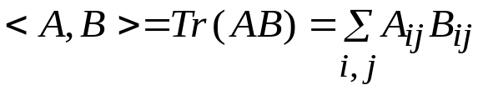
Cone Program
Cone Program
  Cone Program is defined as follows:
  Examples
  (1) LP
  (2) Second Order Cone Program (SOCP): Lorentz Cone (Ice-cream Cone)
  (3) Semi-Definite Program: Defined on the space of m x m symmetric matrices S^{m}
  In S^{m} , the inner product (called Frobenius inner product) is defined as:

Slide 12




Dual Cone Program
Dual Cone Program
  We want to derive dual cone program by using the same approach as LP.
  Since we use a generalized inequality, the problem is what numbers to be used.
Note Inequalities are different!
Conditions on λ?
  Define dual cone K* as follows:
Then we have:
  So dual cone program can be defined as:
Remark: A* is a conjugate operator defined as:
If we use orthogonal bases in both spaces, A* = A^{T}.

Slide 13


Dual Cone Program: Geometry
Primal Dual Pair
  We have primal and dual cone programs. Do they look quite different?
Note the same form as LP!
Geometry
  Feasible region of dual CP = Intersection of Affine Space and Dual Cone K*
  Feasible region of primal CP?
    Use change of variables and pose the problem into the space E.
Remark: If such d doesn’t exist, we can show primal is infeasible or unbounded!
Hence, feasible region of primal CP = Intersection of Affine Space and Cone K!
※ Normal form, Standard form

Slide 14

Dual Cone Program: Duality
Duality Theorem for Cone Program
  Duality Theorem
    Symmetry: Dual of dual is primal.
    Weak duality
    Strong duality
      1) If primal is bounded below and strictly feasible, then dual is solvable and optimal
      values of them are the same.
      2) If dual is bounded above and strictly feasible, then primal is solvable and optimal
      values of them are the same.
    Complementary Slackness
      Assume that at least one of primal and dual is strictly feasible. Then a primal-dual
      feasible pair (x, λ) is optimal if and only if

Slide 15
Dual Cone Program: Duality (cont.)
Duality Theorem for Cone Program: Discussion
  Most of LP duality results hold, but we need strict feasibility…….. Why?
  Note that the feasible region of CP is the intersection of affine space and a cone.
  The cone in general is not polyhedral!
  So if there is very small change on the data (perturbation), the status can change!
  You are now handling with non-polyhedral cones!
  Robustness is needed in practice. So strict feasibility requirement is not a problem.

Slide 16
Cone Program: SOCP and SDP
First Observation on SOCP and SDP: They are self-dual!
  Dual cone of Lorentz cone is also Lorentz cone.
  Dual cone of Semi-definite cone is also Semi-definite cone.
From now on, we will study SOCP and SDP in detail.

Slide 17

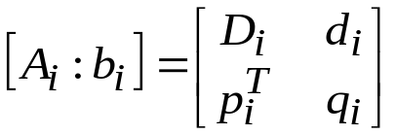


SOCP: Introduction
SOCP: Standard Form (Primal)
Recall Lorentz cone defined as:
Let us define K as Cartesian product of k Lorentz cones (of appropriate dimensions)
Then SOCP in general is defined as:
More explicit form is as follows.
Now we get standard form of SOCP:

Slide 18

SOCP: Introduction
SOCP: Some Observations
SOCP:
Consider a single constraint:
Note that the inequality is of quadratic form.
Easy to note that LP is a special case of SOCP (why?).
One more less easy observation: Quadratic program is a special case of SOCP.
→ Use Epigraph form (more on this later).
The left-hand side is a (square root of) sum of quadratic of linear function.
→ Recall standard deviation from statistics!
Any idea on which problems to SOCP can be applied?

Slide 19


SOCP: Introduction
SOCP: Standard From (Dual)
SOCP:
Let dual variables be:
Then dual SOCP is:
For more explicit form, let us denote:
Then dual SOCP in standard form is:

Slide 20






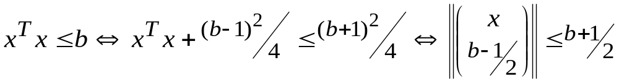
SOCP: Expressive Power
Problems that can be Formulated as SOCP (in General)
General Optimization Problem:
We can always assume the objective function is linear:
So we can write general optimization problem as:
As in the case of LP, to use SOCP, you should be familiar with modeling techniques.
  You have to know which sets (or functions) can be represented as SOCP form.
  Examples

Slide 21
SOCP: Expressive Power
Problems that can be Formulated as SOCP (cont.)
Many sets can be represented in SOCP form.
Usually, you start with basic sets (e.g., sets in the previous slide) and take some operations on the sets that preserve the representability.
  For example, affine image of a set is also SOCP representable.
  Not easy, but if you become familiar, very useful.

Slide 22


SOCP: Robust LP
Robust Linear Programming
  In practice, data uncertainty is very usual.
    Forecasting Error, Measurement Error, etc.
  In LP, c, A, b can be uncertain but we have some sets to which the values should belong.
  Formally, we have the following families of LP’s (U is called an uncertainty set.)
How to solve the problem?
Usual approach is the worst-case-oriented approach. In this case, the robust counterpart is:
In some special cases where U is polyhedral, the problem can be easily solved.
More interesting case is where U is a union of ellipsoids: Consider a simpler case.
In this case, the robust LP becomes SOCP:

Slide 23


SOCP: Stochastic LP
Stochastic Linear Programming
  Chance-Constrained Programming
Let us assume (multivariate) Gaussian distribution:
Then the problem becomes:
where Φ is a Gaussian CDF.

Slide 24
SOCP: Concluding Remarks
Applications of SOCP
  Usual sources of applications of SOCP come from
    Engineering Design Problems: Mechanics, etc
    Robust Linear Model: Finance, Inventory Management, SCM
    For OR people, SOCP can be viewed as a tool to handle data uncertainty on linear model.
Research Topics on SOCP
  Mainly modeling issues.
    What applications can be modeled by SOCP ?
    For e.g., Goldfarb and Iyenger (2003) showed that robust portfolio optimization problem
    can be formulated as SOCP.
    Potentially huge applications in other areas such as problems with demand uncertainty.
  Theoretical and Algorithmic issues

Slide 25
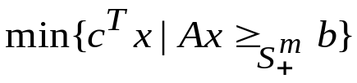


SDP: Introduction
SDP: Standard Form (Primal)
Recall Semi-definite Cone is defined in S^{m}, the space of symmetric m x m matrices.
Caution: In this space, the point is a matrix! (not a usual vector of real numbers).
Frobenius Inner Product defined as:
If we write SDP as usual form in Cone Program, there can exist some confusion.
Note that Ax and b are matrices. So A should be interpreted as a linear mapping from R^{n} to S^{m} and should not be confused with Ax.
To clarify notation, we will use LMI (Linear Matrix Inequality) form:
where A(x) is:
Remark: You can express multiple LMI’s by a single LMI.

Slide 26


SDP: Introduction
SDP: Standard Form (Dual)
For dual, we need to find the conjugate operator.
Then the dual SDP is:

Slide 27


SDP: Modeling Power
SDP: Expressive Power
  Many important applications of SDP uses the fact that functions of eigenvalues of a matrix
  can be represented as SDP.
  Simple example: The largest eigenvalue
Note the above is the subset of m x m symmetric matrices with the largest eigenvalue ≤ t.
You can express the set as LMI as follows:
Other examples
- Sum of k largest eigenvalues
- Spectral norm of a symmetric m x m matrix X
- Negative powers of determinants, e.g., 1/Det(X)
Also you can show SOCP is a special case of SDP.
Usual engineering application of SDP involves the stability of linear system.
  Important application contains Liapunov Stability Theory for uncertain linear system.

Slide 28





SDP: Combinatorial Optimization Application
General SDP Relaxation Scheme: Shor’s Relaxation
  We can formulate (0,1) IP problem as the form:
Note that any Boolean variable can be represented as: .
General relaxation scheme comes from Lagrange relaxation constructed as: .
where .
Note from the above construction, if .
Then ζ is a lower bound on the original problem. .

Slide 29
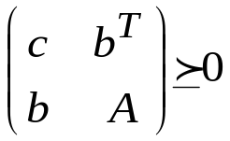

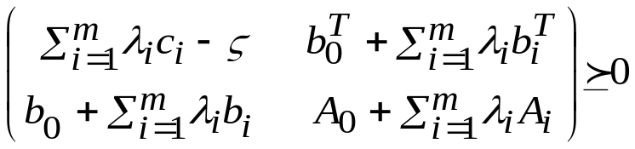
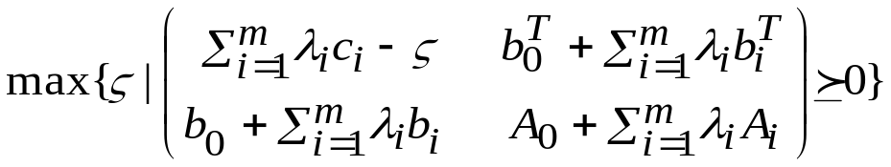
SDP: Combinatorial Optimization Application
General SDP Relaxation Scheme: Shor’s Relaxation (cont.)
Now use the following fact: .
Hence we have: .
Now we get SDP relaxation: .

Slide 30
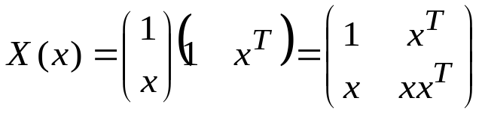
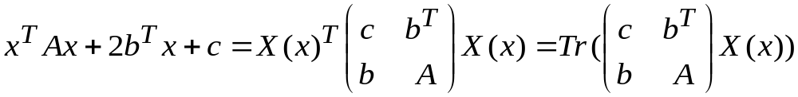
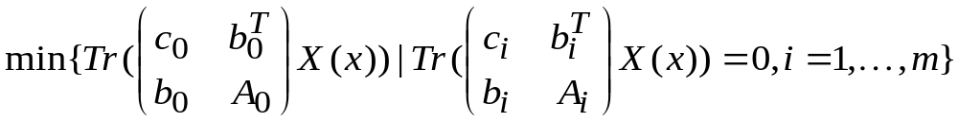
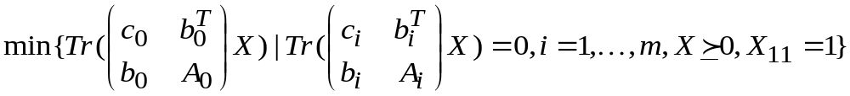
SDP: Combinatorial Optimization Application
General SDP Relaxation Scheme: Shor’s Relaxation – Another Approach
Let’s define the dyadic matrix X(x): .
Hence the original problem can be written as: .
Relaxation can be obtained by noting that X(x) is positive semi-definite with X₁₁ = 1.
The above problem is the dual of SDP presented in the previous slide.

Slide 31

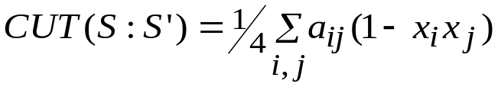
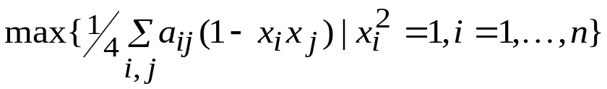
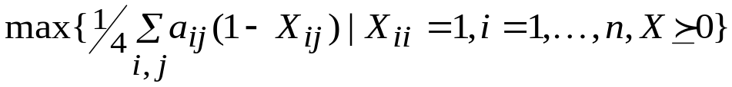
SDP: Combinatorial Optimization Application
Example: Max-Cut
Given a complete graph G with non-negative weights on edges, the problem is to find a cut (S:S’) with the maximum cut capacity.
Note that:
The problem can be formulated as:
If we introduce a matrix variable X=xx^{T}, then X is positive semi-definite with diagonal = 1.
Then using the fact, we can get the following SDP relaxation of Max-Cut (Dual Form):
Goemans and Williamson proved that the above SDP relaxation gives approximate solution of quality 1.138OPT.
Remark: The relaxation used in this problem seems to be different from Shor’s scheme. But you can easily show that they are essentially the same.

Slide 32
SDP: Concluding Remarks
SDP: General Advice
  SDP is a powerful tool to model many engineering design problems, especially those involving
  linear system design.
  The major difficulty when studying SDP comes from the fact that you should deal with matrix
  variables and extensive knowledge on matrix analysis is necessary.
  However, if you master SDP, there will be very interesting problems waiting for you!
Research Topics
  As in the case of SOCP, most of the research focuses on the applicability of SDP.
  Besides engineering applications, combinatorial optimization is one of the most promising
  area of application. For e.g., comparing the quality of relaxation using SDP with others.
  In finance applications, asset pricing problems and robust portfolio optimization problems
  can be handled with SDP, e.g., El Ghaoui (1999) when only partial information on the
  covariance matrix is given.
  Of particular interest, the moment problem is to deal with uncertainty when only partial
  moment information on the random variables is given. This model is robust in that it does not
  assume any particular distribution function. Applications include finance, combinatorial
  optimization (probabilistic analysis of heuristics) and others, see Bertsimas (2000).

Slide 33
Algorithms for Cone Program
Interior Point Algorithm in General
  Newton Method for Unconstrained Convex Optimization
    Use second-order (quadratic) approximation
    Two phases
    1) Damped Phase: When current iterate is far from optimal → Linear Convergence
    2) Pure Newton Phase: When current iterate is near optimal → Quadratic Convergence
  Generic Scheme
    Use barrier function to represent the interior of feasible region
    Convert the problem into unconstrained one by summing the objective and barrier
    functions
    Sequentially solve the problem by Newton method.

Slide 34


Algorithms for Cone Program
Interior Point Algorithm in General
  Classical Interior Penalty Scheme
Given an optimization problem (recall we can assume the objective is linear):
Choose a barrier function (interior penalty function) F(x) satisfying:
Transform the problem into optimization of parametric family of functions:
Under some mild conditions, we can show that:
1) F_{t}(x) has its minimum in the interior of X and the minimizer x*(t) is unique.
2) The central path x*(t) is smooth curve and as t → ∞, the point approaches an optimal
solution of the original problem.
The method: Solve an initial problem and get x*(0)
1) Increase t a bit (Small increase of t will make the current iterate x*(t_{i}) close to x*(t_{i+1})).
2) Solve new problem to get a solution x*(t_{i+1}).

Slide 35
Algorithms for Cone Program
Problems in Classical Interior Penalty Scheme
  The method is straightforward and very intuitive, but
  There is too much freedom (ambiguity) including
    How to update t.
    How to check whether the current iterate is sufficiently close to central path
    How to ensure fast convergence of Newton method
  The result is: We don’t know when the algorithm terminates…….
Cure: Self-Concordant Barrier Functions
  There exists good barrier functions with property called self-concordance.
  With self-concordant barrier functions, we can
    Specify how close the current iterate to central path.
    Updating t is quite simple: Use self-concordance parameter.
    Show the step needed to obtain ε-optimal solution is polynomial.
  The result is: We can make a polynomial time algorithm to obtain ε-optimal solution.
  Remark: Self-concordance barrier function is three times continuously differentiable and
  satisfies two conditions relating first and second derivatives, and second and 3rd derivatives.

Slide 36


Algorithms for Cone Program
Self-Concordance Barrier Function for SOCP and SDP
SOCP case:
SDP case:
Remark 1: For these functions, the calculation of gradient and Hessian is very simple.
Remark 2: The algorithm is called a central path following method.

Slide 37
Cone Program: Concluding Remarks
Cone Program as a Tool of Problem Solving
  Now, CP can be treated as a tool.
    For SOCP, MOSEK can solve very large problem instances very efficiently.
    For SDP, some refinement is needed, but problems with around 2,000 variables can be
    solved in a reasonable time.
  To fully make use of SOCP and SDP,
    Much work remains in the modeling issues.
    Study the full expressive power of SOCP and SDP
Research Suggestions
  Analyze the expressive power of SOCP and SDP in various fields of applications.
  Research on SDP relaxations for Discrete Optimization Problems (and approximation scheme)
  Study other class of useful cone programs.

Slide 38
Journey II
Robust Optimization

Slide 39
Robust Optimization: Introduction
Uncertainty
  We live in a dynamic and uncertain world!
    Speed of change accelerates itself!
    Even worse, the cycle of change gets shorter and shorter….
  But anyway, you plan and act now and see the result in the future.
  How can we handle uncertainty?
Sources of Uncertainty
  Forecasting Error
    Future demand/price/interest rate/weather/etc….
    Any forecasting model has an error term.
    Even worse for long term forecasting
  Measurement Error
    In engineering applications, though there would exist accurate value for an object to be
    measured, error is very usual.
    Precision of measurement, Human error, Computer error, etc

Slide 40
Robust Optimization: Introduction
Modeling Uncertainty
  Of course, the first way of modeling uncertainty is to use probability distributions.
    E.g., probability distribution for future demand
    Two main difficulties
      1) Very difficult to estimate the probability distribution
      2) Very difficult to solve the optimization problem (stochastic program)
    One more less apparent drawback
      The probability distribution itself can be very sensitive to forecasting error.
      To overcome the problem, non-parametric approach (usually based on order statistics) can be used, but the optimization becomes more difficult.
  Uncertainty Set
    Though we cannot exactly specify the value of a parameter, it is reasonably easy to define
    a set in which the parameter takes its value.
    E.g., You can define an interval for next year’s demand for oil.
    Using properly defined uncertainty set makes optimization a tractable one.
    One major drawback is that the solution can be too conservative since we don’t assume
    any probability on the data in the set. (Can take a solution that reflects very rare and worst
    case)

Slide 41
Robust Optimization: Introduction
Robust Optimization
  Uncertainty Set Approach
    Rather than assuming any particular pdf, use uncertainty set to model data uncertainty.
  Worst-case Oriented Approach
    The solution should be feasible for all possible cases that come from the uncertainty set.
    Maximize/Minimize the worst-case revenue/cost.
  Usually, there is a method to control the conservatism of the solution, so some possibility of
  infeasibility can be permitted.
Main Topics in Robust Optimization
  Uncertainty Set: Good uncertainty set has the following properties.
    It should be able to model the data uncertainty effectively.
    The optimization problem (called robust counterpart) should be tractable.
  So the major issue in RO is to develop effective uncertainty set model where its robust
  counterpart should be tractable.

Slide 42

Robust Optimization: Uncertainty Set
Popular Uncertainty Set Models
  Ellipsoid
    To model multiple parameter values.
    Defined by nominal values of parameters and a symmetric positive definite matrix
Remark 1: Ellipsoid uncertainty set is very useful to model forecasting errors from regression.
Remark 2: LP with ellipsoidal uncertainty set becomes SOCP.
  Interval Set
    To model independent parameter values.
    Defined by a nominal value with its maximum possible deviation
Remark 1: Interval uncertainty set is very easy to estimate. But also independency may matter.
Remark 2: Linear model with interval uncertainty set will be linear model (more on this later)
Remark 3: Generalization to polyhedral uncertainty set is possible.

Slide 43
Bertsimas and Sim Model
Bertsimas and Sim Model
  Uses Interval Uncertainty Set
    Robust counterpart of linear model remains linear.
    → LP, IP: Broad applicability
    Robust counterpart of discrete optimization problem with polynomial time solvability can
    also be solved in a polynomial time.
  Method to control conservatism: The probability of constraint violation can be controlled by a
  single parameter.

Slide 44




Bertsimas and Sim Model
Bertsimas and Sim Model (in Detail)
  LP with interval uncertainty set
Remark: Γ is the number of parameters that takes its extreme value simultaneously.

Slide 45



Bertsimas and Sim Model
Bertsimas and Sim Model (in Detail)
Note the following fact (LP duality)
So the problem becomes:
Remark 1: Still LP with moderately larger size
Remark 2: In case of IP, still IP with moderately larger size
Remark 3: Γ can be chosen to reflect the probability of constraint violation.

Slide 46

Example of Robust Optimization Application
Robust Portfolio Selection (Goldfarb and Iyenger 2003)
Use multi-factor model for asset return:
Uncertainty Set✓
  Mean return: Interval (min and max is given.)
  Columns of factor loading matrix: Ellipsoid
  Variance of residual: Interval
Result: Robust counterpart is SOCP. (Note the original portfolio optimization problem is a quadratic programming model.)

Slide 47
Robust Optimization: Concluding Remarks
Robust Optimization as a Tractable Method to Handle Data Uncertainty
  Much more practical applicability than stochastic programming approach
  The key to success is how to model U:
    Effective to capture the uncertainty and also easy to define
    Tractable robust counterpart e.g., LP, IP, SOCP, SDP
Research Suggestions
  Research on Uncertainty Set Modeling
    For example, to which uncertainty sets, SOCP can handle?
    Develop specific uncertainty set modeling for particular field of application
  Extension of IP
    Apply Bertsimas and Sim framework to various IP models.
  Theoretical Issues
    Linking Stochastic Programming (especially, chance-constrained program) and RO

Slide 48
Discussion and Q&A

